Slide 1
CSE 471 - Lab 03
Use Case Diagram

Slide 2
Use Case
Describes user requirements
Better understanding of users’ interaction with the system
Useful in cases where user interactions are key
Actor, Function, Goal/Value
Set of use cases and actors combined into Use Case Diagram
Functional view of the system from user perspective

Slide 3

Use Case Diagram : Actors
Act on the system
Execute system functionalities
Provide information to system
Receive information as output from system
Types :
Primary : Initiate the use cases to achieve goal
Secondary : Support the system in achieving Primary Actors’ goal
External Hardware : E.g. timer, remote data-centers
Another System

Slide 4
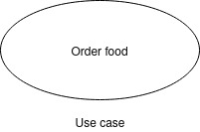
Use Case Diagram : Use Cases
System functionalities that actors execute to achieve goal
Part of the system

Slide 5
Use Case Diagram : System Boundary
Defines scope of the system
Separates internal components from external
System Name

Slide 6
Use Case Diagram : Relations
Represent interactions among components
Types:
Association : Actor <-> Use case.
Generalization : Parent-Child relation. Actor <-> Actor or Use case <-> Use case
Dependency : Use case <-> Use case.

Slide 7
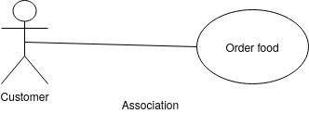
Use Case Diagram : Relations
Association

Slide 8
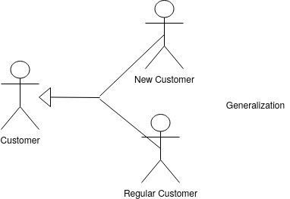
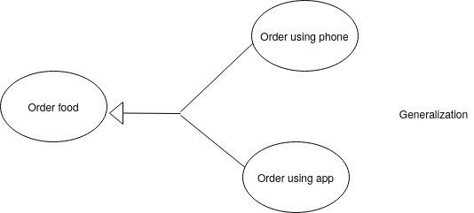
Use Case Diagram : Relations
Generalization

Slide 9


Use Case Diagram : Relations
Dependency
Include :
Base use case includes functionality of another mandatory use case
Extract common functionalities and share among use cases
Extend :
Optional use case extends base use case

Slide 10
Microwave Example : 1
User can heat up food

Slide 11

Microwave Example : 1
User can heat up food

Slide 12
Microwave Example : 2
User can cook food as well, common use case is starting the timer

Slide 13
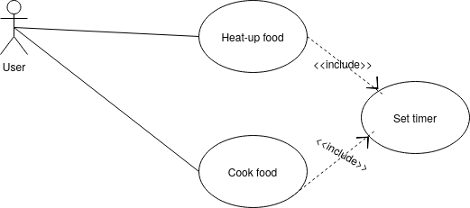
Microwave Example : 2
User can cook food as well, common use case is starting the timer

Slide 14
Microwave Example : 3
User can choose to slice/decorate food

Slide 15
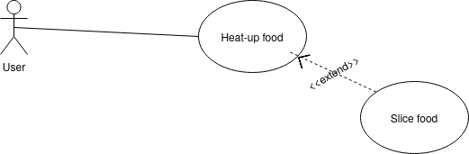
Microwave Example : 3
User can choose to slice/decorate food

Slide 16
Scenario : Refugee Management
Hope Refugee Agency, is known for its work on the well-being of climate refugees. They have a head office in Dhaka where the management decides plan of action at the beginning of each quarter, based on which field officers carry out programmes. Field officers from different departments are responsible for their respective programs. Health officers focus on nutritional assessment of children and their development. If any child is malnourished, they are included in special treatment programs where children are monitored to assess the effectiveness of the program. On the other hand, education officers devise learning modules, assess students' progress. If any student needs extra care, they are also assigned to special needs programs based on the type of help they require. Both health and education officers are required to fill-in respective reports. Whenever a report is filed, it is automatically uploaded to the central database. Field officers can also make recommendations based on their observations to management. Management generates quarterly reports.

Slide 17
Scenario : Refugee Management
Hope Refugee Agency, is known for its work on the well-being of climate refugees. They have a head office in Dhaka where the management decides plan of action at the beginning of each quarter, based on which field officers carry out programmes. Field officers from different departments are responsible for their respective programs. Health officers focus on nutritional assessment of children and their development. If any child is malnourished, they are included in special treatment programs where children are monitored to assess the effectiveness of the program. On the other hand, education officers devise learning modules, assess students' progress. If any student needs extra care, they are also assigned to special needs programs based on the type of help they require. Both health and education officers are required to fill-in respective reports. Whenever a report is filed, it is automatically uploaded to the central database. Field officers can also make recommendations based on their observations to management. Management generates quarterly reports.

Slide 18
Scenario : Refugee Management
Hope Refugee Agency, is known for its work on the well-being of climate refugees. They have a head office in Dhaka where the management decides plan of action at the beginning of each quarter, based on which field officers carry out programmes. Field officers from different departments are responsible for their respective programs. Health officers focus on nutritional assessment of children and their development. If any child is malnourished, they are included in special treatment programs where children are monitored to assess the effectiveness of the program. On the other hand, education officers devise learning modules, assess students' progress. If any student needs extra care, they are also assigned to special needs programs based on the type of help they require. Both health and education officers are required to fill-in respective reports. Whenever a report is filed, it is automatically uploaded to the central database. Field officers can also make recommendations based on their observations to management. Management generates quarterly reports.

Slide 19
Scenario : Refugee Management
Hope Refugee Agency, is known for its work on the well-being of climate refugees. They have a head office in Dhaka where the management decides plan of action at the beginning of each quarter, based on which field officers carry out programmes. Field officers from different departments are responsible for their respective programs. Health officers focus on nutritional assessment of children and their development. If any child is malnourished, they are included in special treatment programs where children are monitored to assess the effectiveness of the program. On the other hand, education officers devise learning modules, assess students' progress. If any student needs extra care, they are also assigned to special needs programs based on the type of help they require. Both health and education officers are required to fill-in respective reports. Whenever a report is filed, it is automatically uploaded to the central database. Field officers can also make recommendations based on their observations to management. Management generates quarterly reports.

Slide 20
Scenario : Refugee Management
Hope Refugee Agency, is known for its work on the well-being of climate refugees. They have a head office in Dhaka where the management decides plan of action at the beginning of each quarter, based on which field officers carry out programmes. Field officers from different departments are responsible for their respective programs. Health officers focus on nutritional assessment of children and their development. If any child is malnourished, they are included in special treatment programs where children are monitored to assess the effectiveness of the program. On the other hand, education officers devise learning modules, assess students' progress. If any student needs extra care, they are also assigned to special needs programs based on the type of help they require. Both health and education officers are required to fill-in respective reports. Whenever a report is filed, it is automatically uploaded to the central database. Field officers can also make recommendations based on their observations to management. Management generates quarterly reports.

Slide 21
Scenario : Refugee Management
Hope Refugee Agency, is known for its work on the well-being of climate refugees. They have a head office in Dhaka where the management decides plan of action at the beginning of each quarter, based on which field officers carry out programmes. Field officers from different departments are responsible for their respective programs. Health officers focus on nutritional assessment of children and their development. If any child is malnourished, they are included in special treatment programs where children are monitored to assess the effectiveness of the program. On the other hand, education officers devise learning modules, assess students' progress. If any student needs extra care, they are also assigned to special needs programs based on the type of help they require. Both health and education officers are required to fill-in respective reports. Whenever a report is filed, it is automatically uploaded to the central database. Field officers can also make recommendations based on their observations to management. Management generates quarterly reports.

Slide 22
Steps of Creating a Use Case Diagram
Identify actors
Identify use cases
Draw the system boundary
Place the actors and use cases on the diagram
Extract common (include) and additional (extend) functionalities for use cases
Use generalizations where applicable
Add association relationships

Slide 23
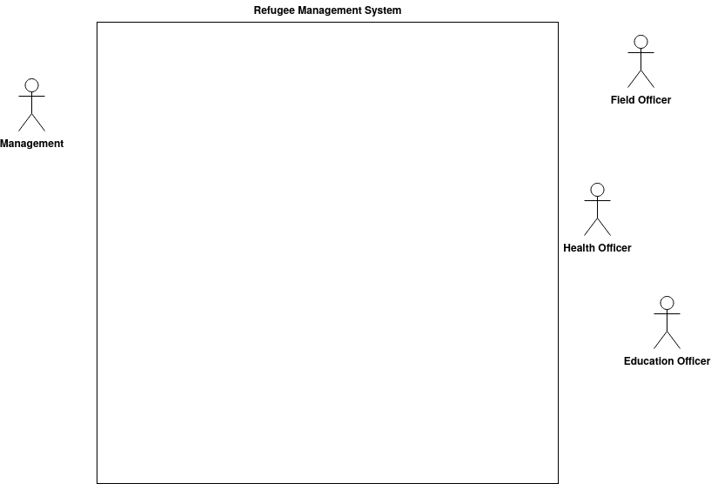

Slide 24
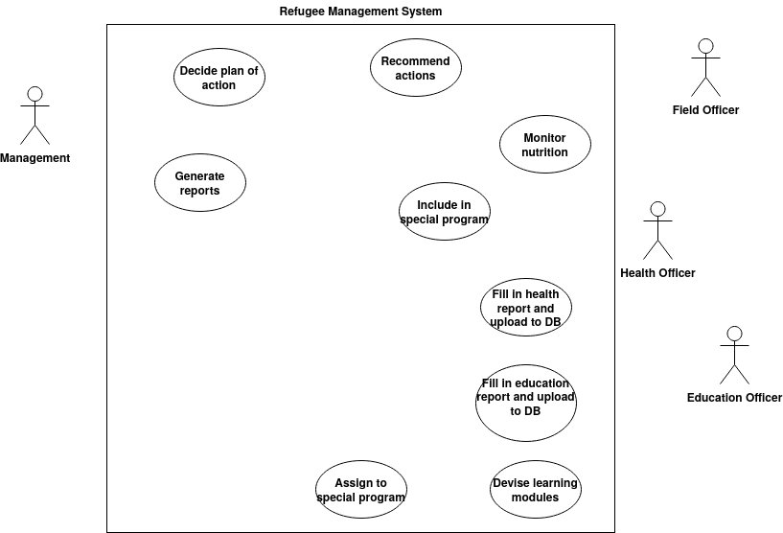

Slide 25
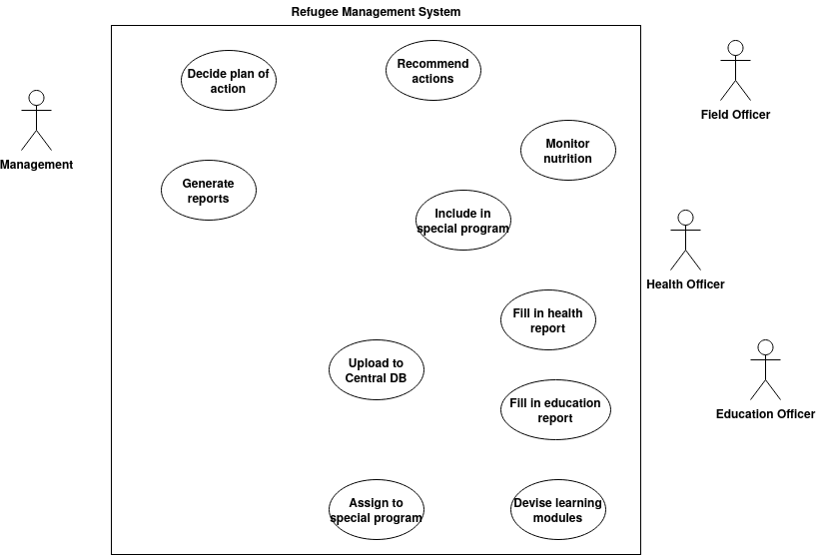

Slide 26
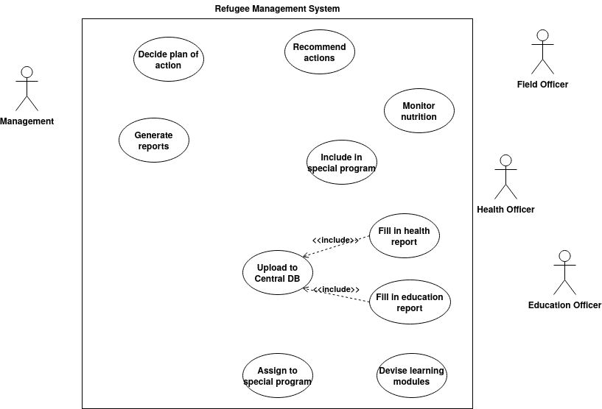

Slide 27
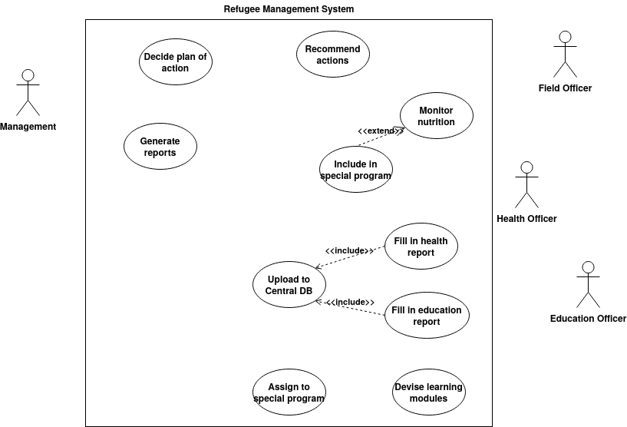

Slide 28
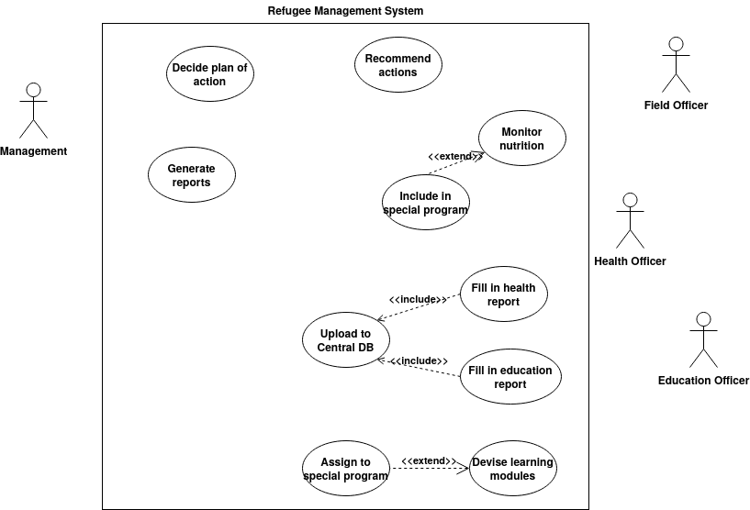

Slide 29
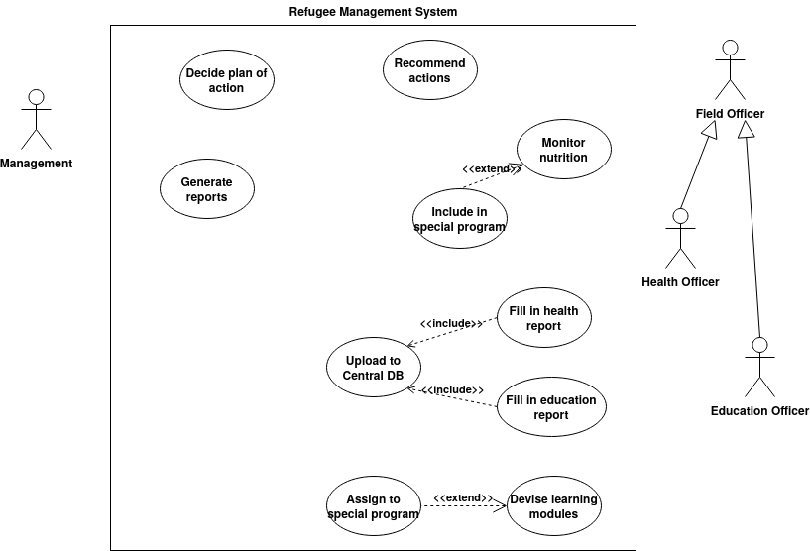

Slide 30
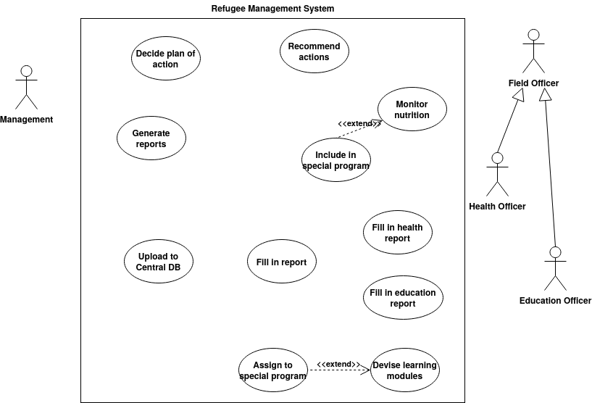

Slide 31
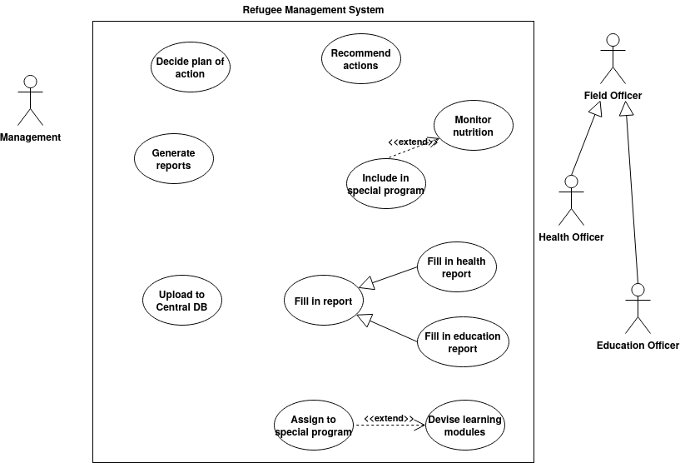

Slide 32
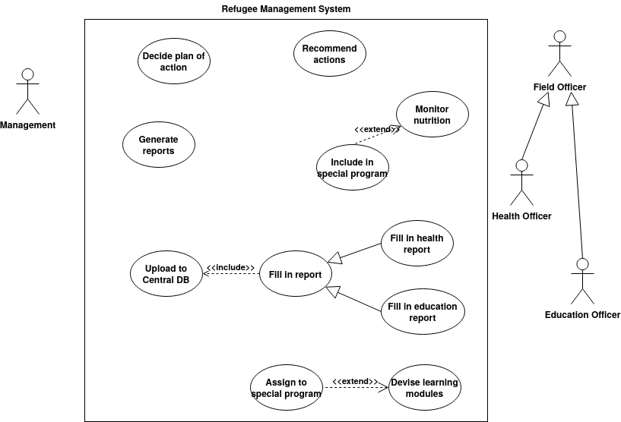

Slide 33
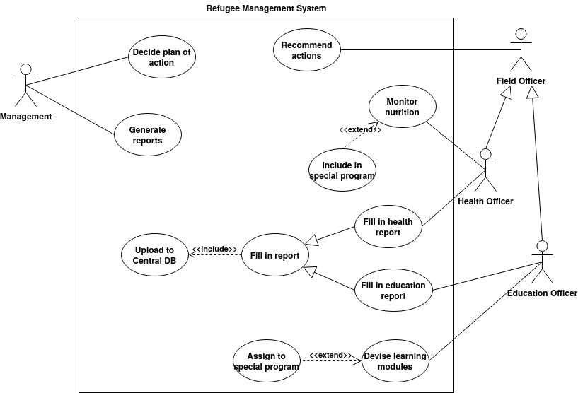

Slide 34
Steps of Creating a Use Case Diagram
Identify use cases
Identify actors
Extract common (include) and additional (extend) functionalities for use cases
Use generalizations where applicable
Draw the system boundary
Place the actors and use cases on the diagram
Add association relationships

Slide 35
Use Case Description
Use case name
ID
Priority
Actor
Description
Trigger : External, Temporal
Preconditions
Normal flow of steps
Postconditions
Exceptions

